Slide 1
ATL Academy
Java Persistence API (JPA)

Slide 2
ORM ( object-relational mapping)
The Java ORM standard for storing, accessing, and managing Java objects in a relational database
While they differ in execution, every JPA implementation provides some kind of ORM layer. In order to understand JPA and JPA-compatible tools, you need to have a good grasp on ORM.

Slide 3
JPA
The Java Persistence API (JPA) is a Java specification for accessing, persisting, and managing data between Java objects / classes and a relational database. JPA was defined as part of the EJB 3.0 specification as a replacement for the EJB 2 CMP Entity Beans specification.

Slide 4
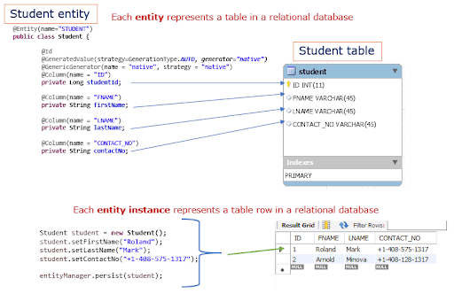
JPA and Database

Slide 5
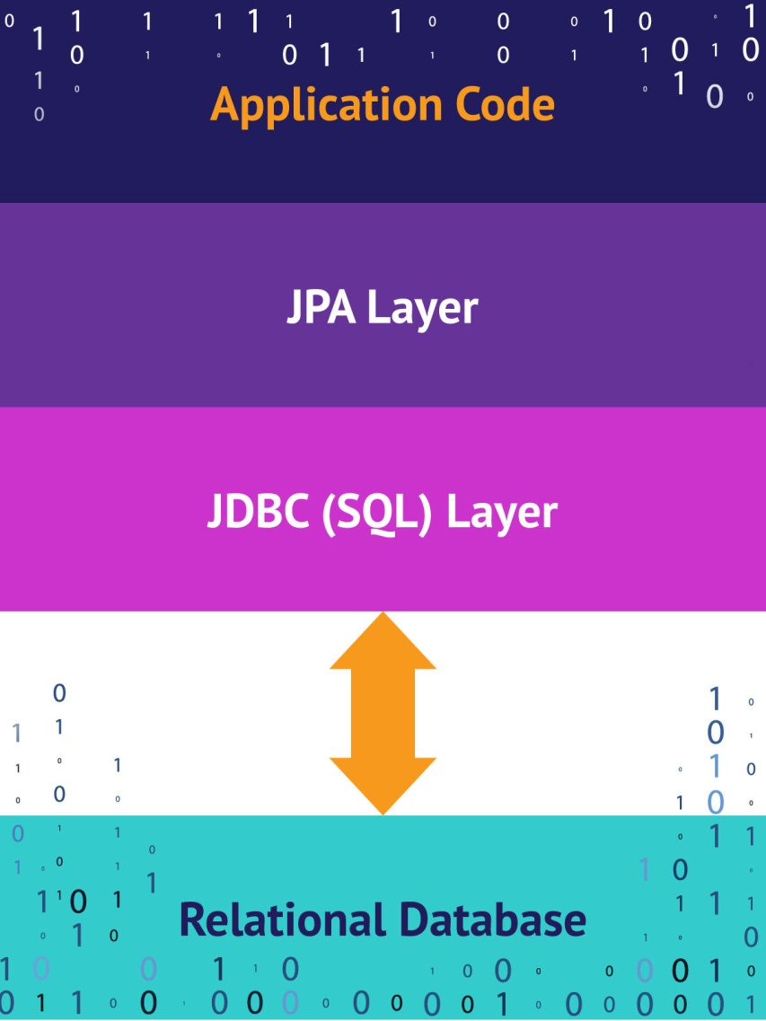
App Code mapping to DB

Slide 6
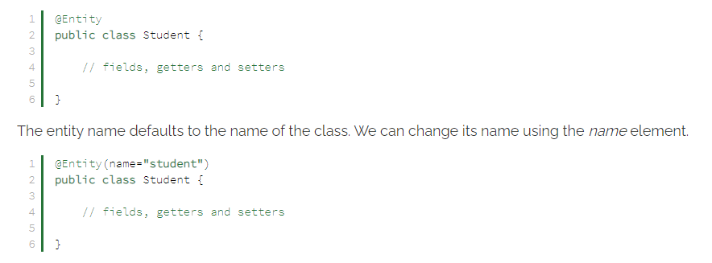
@Entity
The @Entity annotation is used to specify that the currently annotate class represents an entity type. Unlike basic and embeddable types, entity types have an identity and their state is managed by the underlying Persistence Context.

Slide 7

@Table
The @Table annotation is used to specify the primary table of the currently annotated entity.

Slide 8
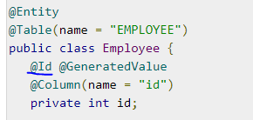
@Id
The @Id annotation specifies the entity identifier. An entity must always have an identifier attribute, which is used when loading the entity in a given Persistence Context.

Slide 9
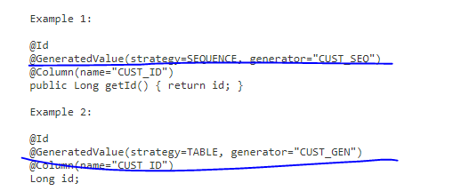
@GeneratedValue
The @GeneratedValue annotation specifies that the entity identifier value is automatically generated using an identity column, a database sequence, or a table generator. Hibernate supports the @GeneratedValue mapping even for UUIDidentifiers.

Slide 10
GenerationType (strategy)
AUTOIndicates that the persistence provider should pick an appropriate strategy for the particular database.
IDENTITYIndicates that the persistence provider must assign primary keys for the entity using a database identity column.
SEQUENCEIndicates that the persistence provider must assign primary keys for the entity using a database sequence.
TABLEIndicates that the persistence provider must assign primary keys for the entity using an underlying database table to ensure uniqueness.

Slide 11
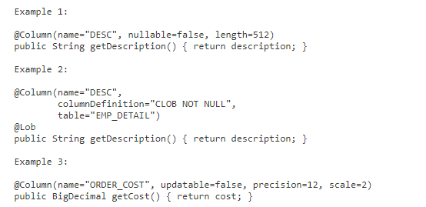
@Column
The @Column annotation is used to specify the mapping between a basic entity attribute and the database table column.

Slide 12
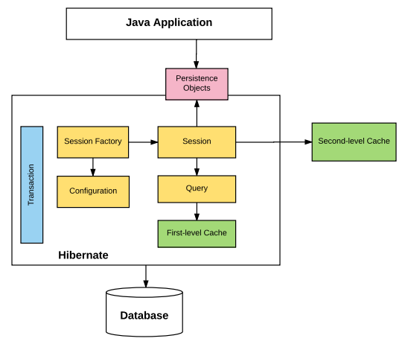
How works Hibernate

Slide 13
Dependecy
<!-- https://mvnrepository.com/artifact/org.hibernate/hibernate-core --> <dependency> <groupId>org.hibernate</groupId> <artifactId>hibernate-core</artifactId> <version>5.4.20.Final</version> </dependency> <!-- Mysql Connector --> <dependency> <groupId>mysql</groupId> <artifactId>mysql-connector-java</artifactId> <version>8.0.17</version> </dependency>

Slide 14
hibernate.cfg.xml
hibernate.cfg.xml file must be under resource folder.
<hibernate-configuration> <session-factory> <!-- SQL Dialect --> <property name="hibernate.dialect">org.hibernate.dialect.MySQL8Dialect</property> <!-- Database Connection Settings --> <property name="hibernate.connection.driver_class">com.mysql.cj.jdbc.Driver</property> <property name="hibernate.connection.url">jdbc:mysql://localhost:3306/hr</property> <property name="hibernate.connection.username">root</property> <property name="hibernate.connection.password">root</property> <property name="show_sql">true</property> <property name="hibernate.hbm2ddl.auto">update</property> <!-- Specifying Session Context --> <property name="hibernate.current_session_context_class">org.hibernate.context.internal.ThreadLocalSessionContext</property> <!-- Mapping With Model Class Containing Annotations --> <mapping class="entity.User" /> </session-factory> </hibernate-configuration>

Slide 15
Create session
private static SessionFactory buildSessionFactory() { Configuration configObj = new Configuration(); configObj.configure("hibernate.cfg.xml"); configObj.addAnnotatedClass(User.class); ServiceRegistry serviceRegistryObj = new StandardServiceRegistryBuilder().applySettings(configObj.getProperties()).build(); sessionFactoryObj = configObj.buildSessionFactory(serviceRegistryObj); return sessionFactoryObj; }

Slide 16
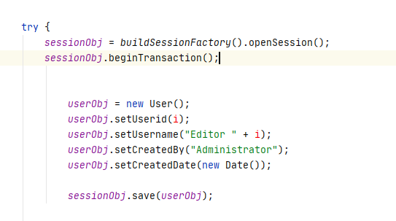
Hibernate Transaction

Slide 17
Relation annotations
javax.persistence.ManyToMany
javax.persistence.ManyToOne
javax.persistence.OneToMany
javax.persistence.OneToOne
javax.persistence.CascadeType
javax.persistence.FetchType
javax.persistence.OrderBy

Slide 18
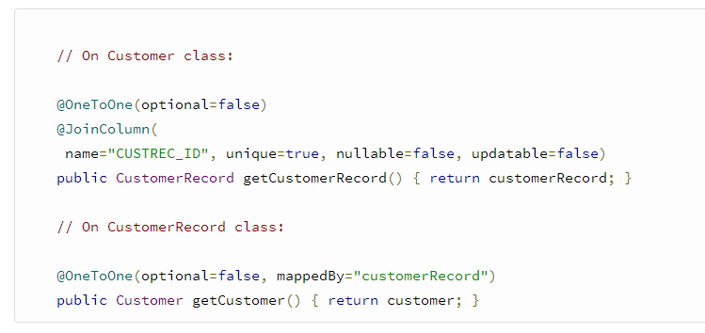
@OneToOne

Slide 19
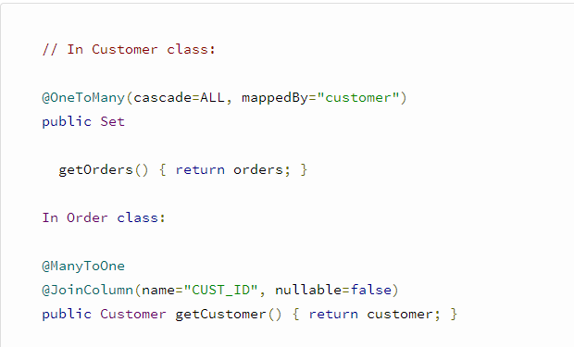
@OneToMany

Slide 20
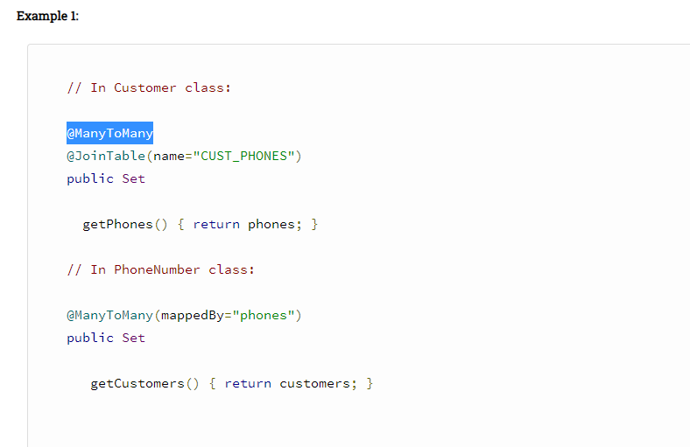
@ManyToMany

Slide 21
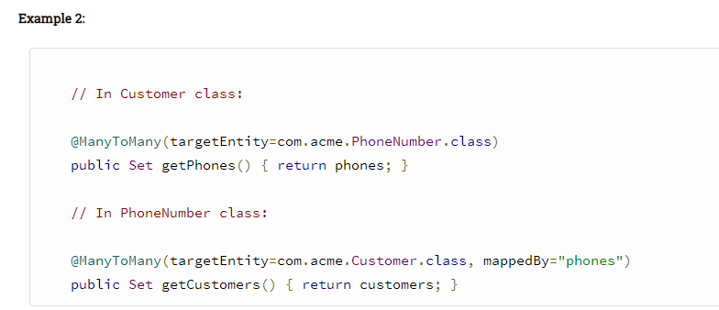
@ManyToMany

Slide 22
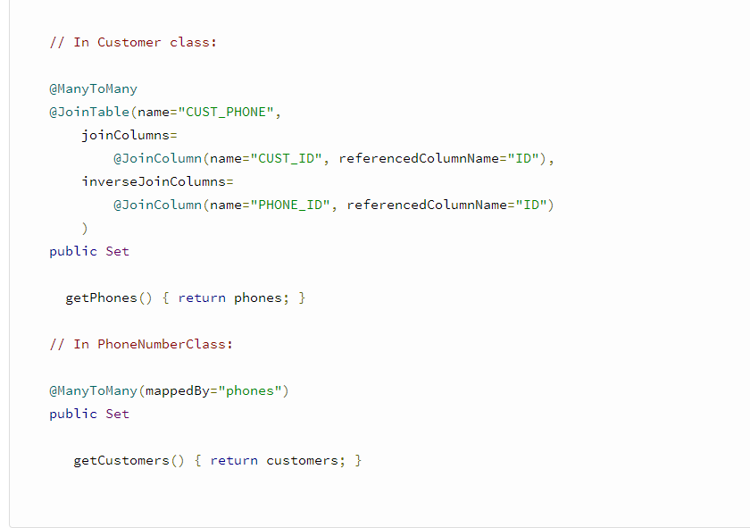
@ManyToMany

Slide 23
@CascadeType
ALL - propagates all operations — including Hibernate-specific ones — from a parent to a child entity.
PERSIST - propagates the persist operation from a parent to a child entity.
MERGE - propagates the merge operation from a parent to a child entity.
REMOVE - propagates the remove operation from parent to child entity
REFRESH - When we use this operation with CascadeType REFRESH, the child entity also gets reloaded from the database whenever the parent entity is refreshed.
DETACH - When we use CascaseType.DETACH, the child entity will also get removed from the persistent context.
@OneToMany(mappedBy = "person", cascade = CascadeType.ALL)
private List<Address> addresses;

Slide 24
@FetchType
Eager Loading is a design pattern in which data initialization occurs on the spot
Lazy Loading is a design pattern which is used to defer initialization of an object as long as it's possible
@OneToMany(fetch = FetchType.LAZY, mappedBy = "user")

Slide 25
@OrderBy

Slide 26
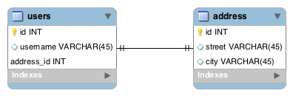
@OneToOne

Slide 27
User
@Entity @Table(name = "users") public class User { @Id @GeneratedValue(strategy = GenerationType.AUTO) @Column(name = "id") private Long id; //... @OneToOne(cascade = CascadeType.ALL) @JoinColumn(name = "address_id", referencedColumnName = "id") private Address address; // ... getters and setters }

Slide 28
@Entity @Table(name = "address") public class Address { @Id @GeneratedValue(strategy = GenerationType.AUTO) @Column(name = "id") private Long id; //... @OneToOne(mappedBy = "address") private User user; //... getters and setters }

Slide 29
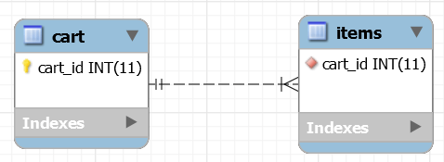
@OneToMany

Slide 30
Cart
@Entity @Table(name="CART") public class Cart { //... @OneToMany(mappedBy="cart") private Set<Items> items; // getters and setters }

Slide 31
Items
@Entity @Table(name="ITEMS") public class Items { //... @ManyToOne @JoinColumn(name="cart_id", nullable=false) private Cart cart; public Items() {} // getters and setters }

Slide 32
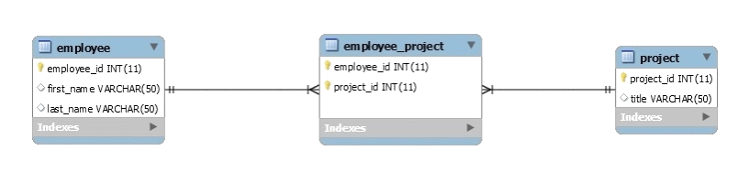
@ManyToMany

Slide 33
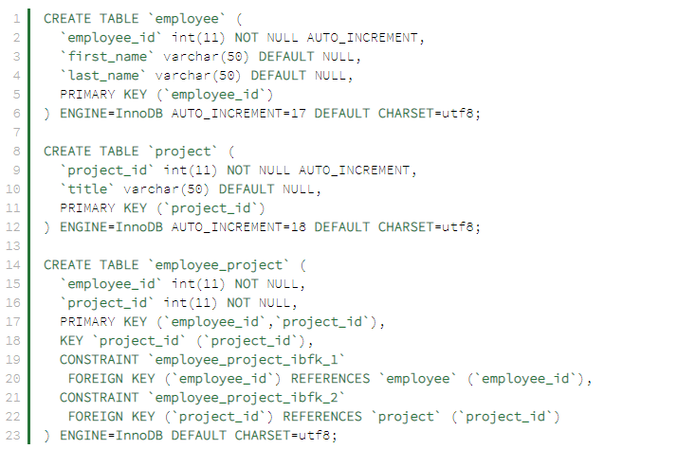
Database structure

Slide 34
Employee
@Entity @Table(name = "Employee") public class Employee { // ... @ManyToMany(cascade = { CascadeType.ALL }) @JoinTable( name = "Employee_Project", joinColumns = { @JoinColumn(name = "employee_id") }, inverseJoinColumns = { @JoinColumn(name = "project_id") } ) Set<Project> projects = new HashSet<>(); // standard constructor/getters/setters }

Slide 35
Project
@Entity @Table(name = "Project") public class Project { // ... @ManyToMany(mappedBy = "projects") private Set<Employee> employees = new HashSet<>(); // standard constructors/getters/setters }

Slide 36
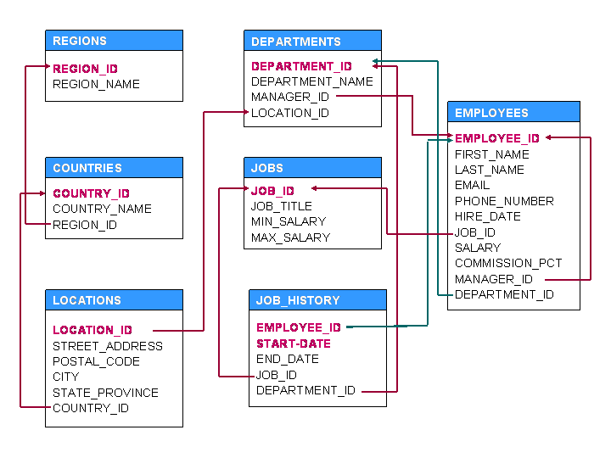
Task
Create Entity and Relation

Slide 37
Links and References
https://www.javaguides.net/2018/11/all-jpa-annotations-mapping-annotations.html
https://www.infoworld.com/article/3379043/what-is-jpa-introduction-to-the-java-persistence-api.html
https://examples.javacodegeeks.com/enterprise-java/hibernate/hibernate-maven-example/
https://dzone.com/articles/all-jpa-annotations-mapping-annotations
https://hibernate.org/orm/releases/5.4/
https://www.objectdb.com/api/java/jpa/annotations/orm
https://www.baeldung.com/jpa-one-to-one
https://www.baeldung.com/hibernate-one-to-many
https://www.baeldung.com/hibernate-many-to-many
https://www.baeldung.com/jpa-cascade-types

